Slide 1
Y Axis
Sin θ = ( y / 1 ) = y
Cos θ = (x / 1 ) = x
( x , y )
R = 1
y
θ
X Axis
x

Slide 2
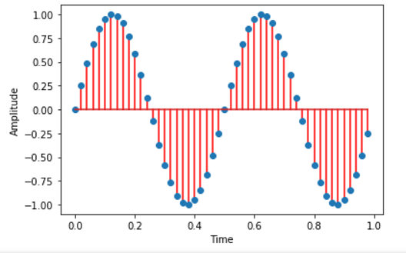
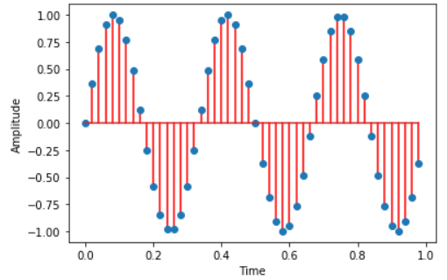
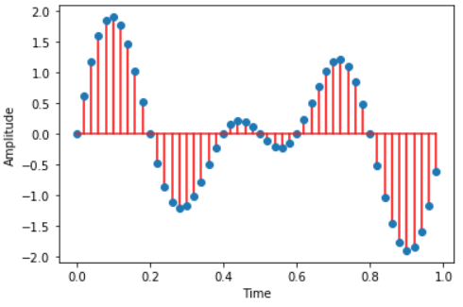
+
=
Fs = 50, t = 1 , f=2
Fs = 50, t = 1 , f=3
Fs = 50, t = 1 , f=3
Component Waves
Final Sound Wave

Slide 3
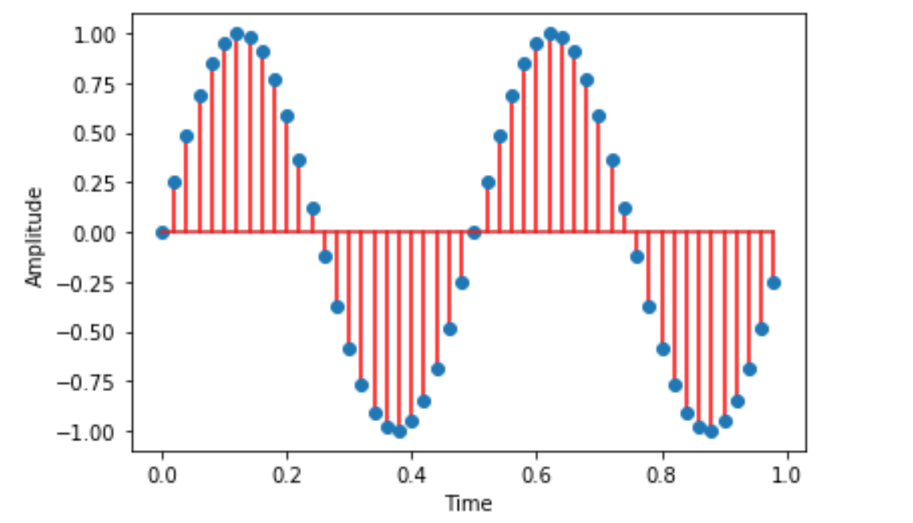
2nd Complete Cycle of Sin wave
1st Complete Cycle of Sin wave
Samples
( Total 50 Samples Collected in 1 time unit )
1 Time Unit (in Secs)

Slide 4
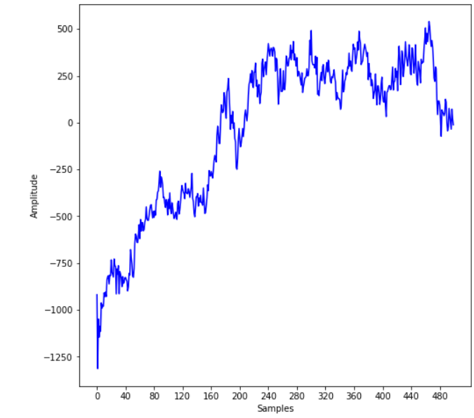
Frame 4
Frame 3
Frame 2
Frame Step of 80 Samples
Frame 1

Slide 5
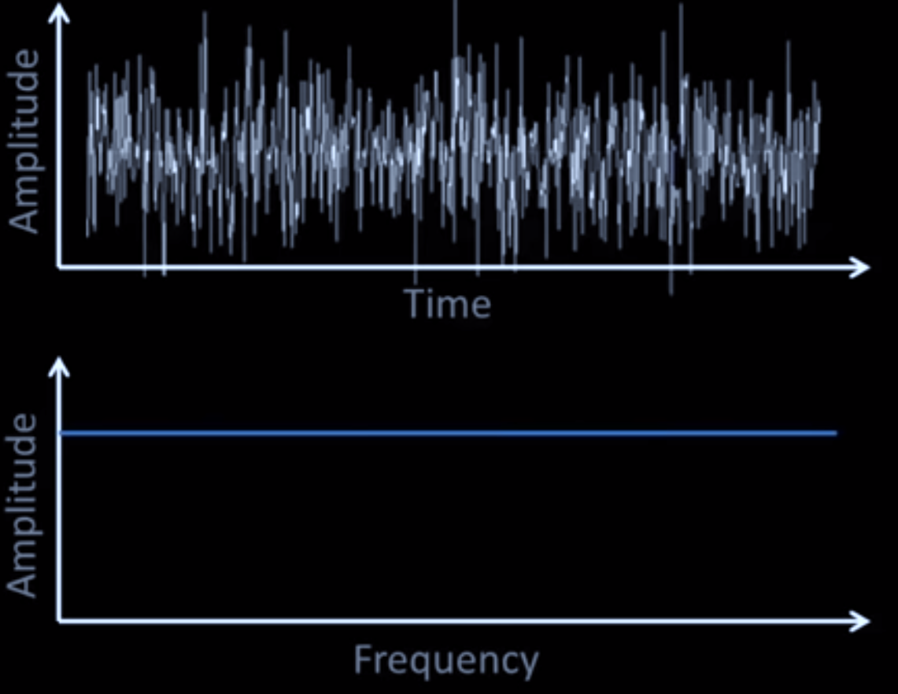
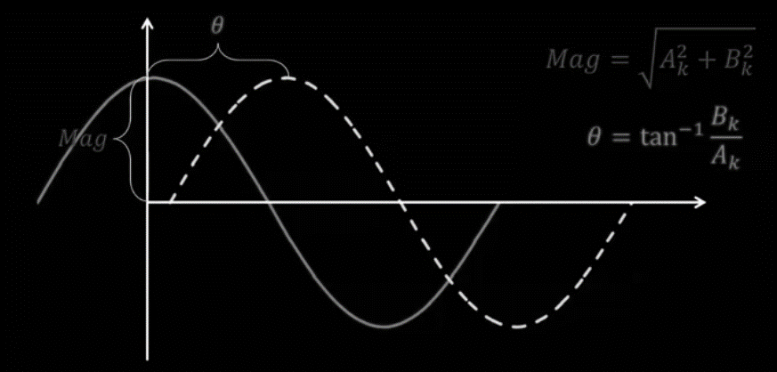







Imag (i)
Magnitude = $\sqrt{A_{k}^{2}+B_{k}^{2}}$
( , )
$$A_{k}$$
$$B_{k}$$
Angle = $\frac{1}{tan}\frac{B_{k}}{A_{k}}$
$$B_{k}$$
Magnitude
$$θ$$
$$A_{k}$$
Real

Slide 6
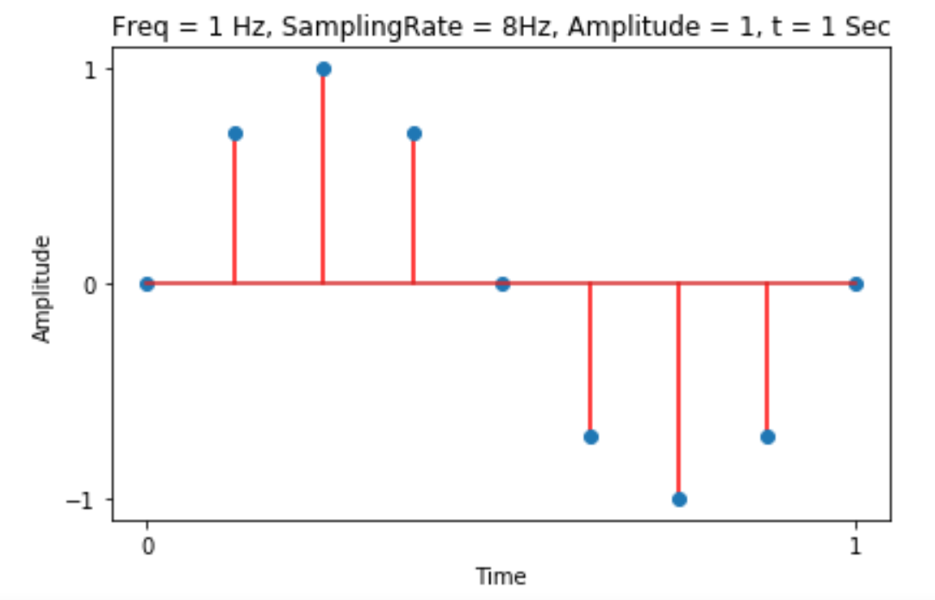
1
0.707
0.707
0
-0.707
-0.707
-1
Input Signal in Time Domain

Slide 7

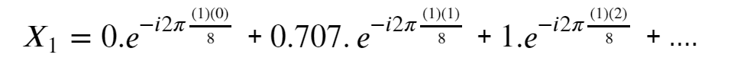
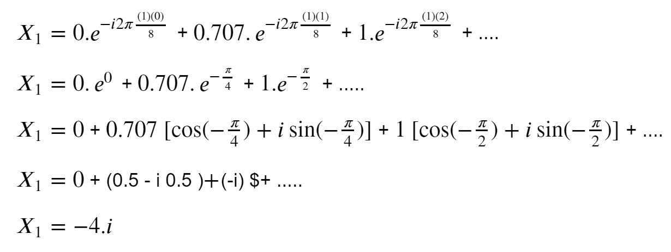
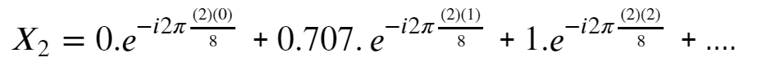









Fourier Transformation for Discrete Signal of N samples
Amplitude of each sample points are ,
$$x_{0}= 0$$
$$x_{1}= 0.707$$
$x_{2}=$1
$$x_{3}= 0.707$$
$$x_{5}= −0.707$$
$$x_{4}= 0$$
$x_{6}= −$1
$$x_{7}= −0.707$$
From the equation lets calculate amplitudes of each frequency bin as follows,
Samewise we can calculate values for $X_{2} ,X_{3} …..X_{7} .$

Slide 8
























Calculated Fourier Coefficients at different frequency bins and their magnitudes/amplitudes are ,
$$X_{0}=0$$
Magnitude =$\sqrt{0^{2}+0^{2}}=0$
Amplitude
$X_{1}=0−4i$
Magnitude =$\sqrt{0^{2}+{(−4)}^{2}}=$4
4
$$X_{2}=0$$
Magnitude =$\sqrt{0^{2}+0^{2}}=0$
Transformation
$$X_{3}=0$$
Magnitude =$\sqrt{0^{2}+0^{2}}=0$
${ X}_{4}$ = 0
Magnitude =$\sqrt{0^{2}+0^{2}}=0$
$$X_{2}$$
$$X_{3}$$
$$X_{4}$$
$$X_{5}$$
$$X_{6}$$
$$X_{7}$$
$$X_{0}$$
$$X_{1}$$
$${ X}_{5}=0$$
Magnitude =$\sqrt{0^{2}+0^{2}}=0$
Frequency (Hz)
$${ X}_{6}=0$$
Magnitude =$\sqrt{0^{2}+0^{2}}=0$
$${ X}_{7}=0+4i$$
Magnitude =$\sqrt{0^{2}+{(4)}^{2}}=$ 4
In the above plot we can see that after Fourier transformation the signal has amplitude of 4 at frequency bins 1Hz and 7Hz.
Our input signal was having amplitude of 1 so the after Fourier transformation we should expect amplitude 1 at frequency bin 1Hz.

Slide 9







Amplitude
As per the Nyquist Theorem , it is impossible to measure anything above the Nyquist Limit which is equal to (Sampling Rate / 2). In this case Nyquist limit is (8/2) = 4 Hz.
So, as per the theorem, anything above this Nyquist limit is added to the value below to the limit. So we had 4 amplitude at 7Hz frequency which is above Nyquist frequency of 4Hz. So this 4 amplitude is being added to amplitude at 1 Hz frequency which is below the Nyquist frequency. And the plot changes to as showed in the right.
8
$$X_{0}$$
$$X_{1}$$
$$X_{2}$$
$$X_{3}$$
$$X_{4}$$
$$X_{5}$$
$$X_{6}$$
$$X_{7}$$
1Hz
Amplitude
In the final step the amplitude is divided by number of sample points to get average amplitude. So in this case amplitude of 8 is divided by 8 (Bcz we had 8 sample points) and the average amplitude is 1 at frequency bin 1Hz. And the plot changes to as showed in the right.
This is the plot of input sin wave in frequency domain where Y-Axis corresponds to amplitude of the signal and X-axis corresponds to Frequency Bins.
1
$$X_{1}$$
$$X_{2}$$
$$X_{3}$$
$$X_{4}$$
$$X_{5}$$
$$X_{6}$$
$$X_{7}$$
Frequency (Hz)
1Hz

